Slide 1





Lesson 3:Catch the Bus

Slide 2
Slide

Slide 3
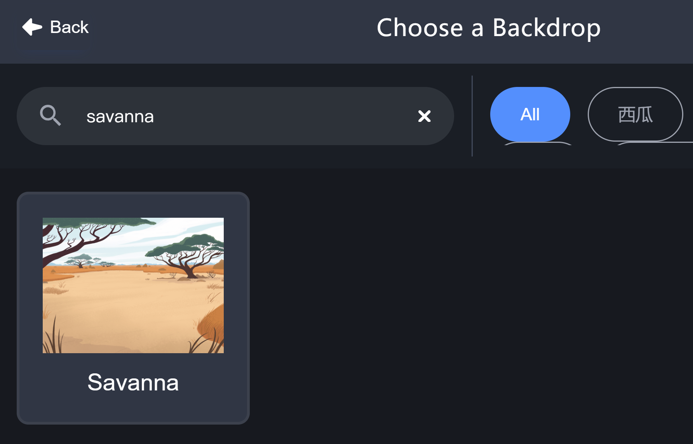
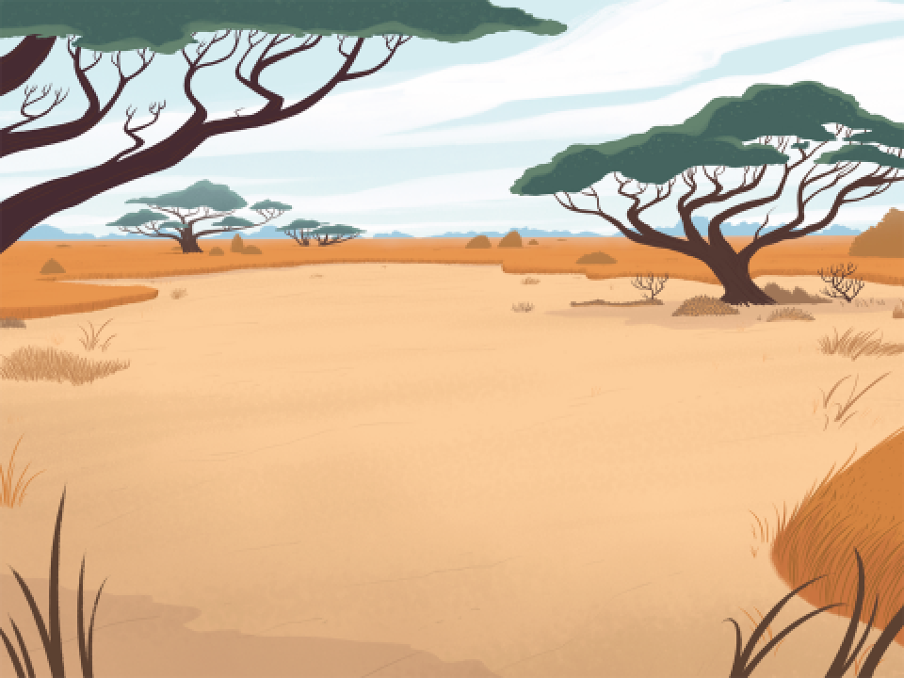
Backdrop - Savanna

Slide 4

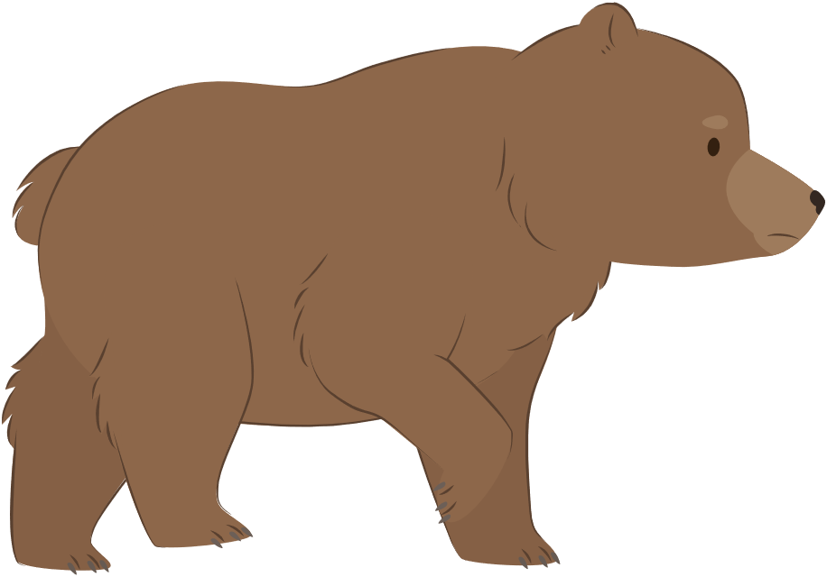

Animal Sprites
Bear
Parrot
Hedgehog

Slide 5
Change Sprite Size
size: 50
size: 100
size: 200

Slide 6
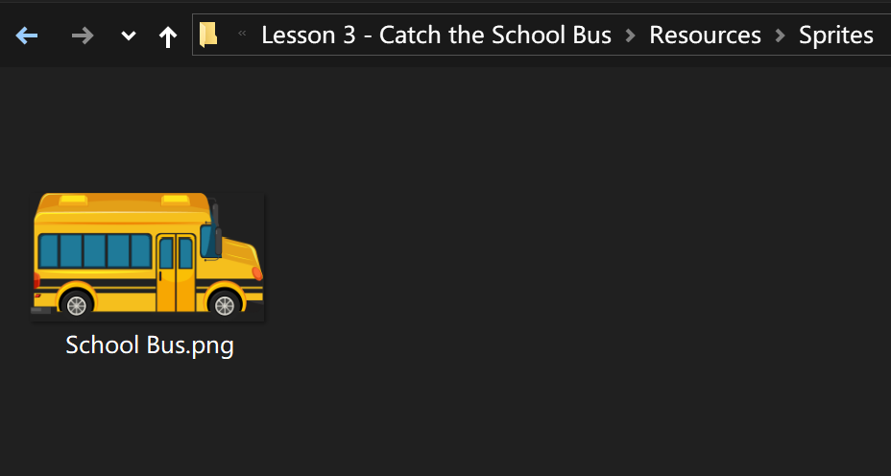

School Bus

Slide 7
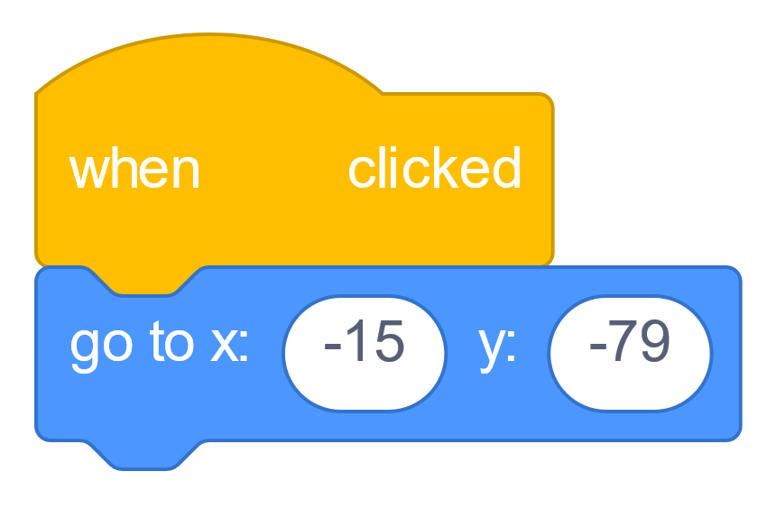
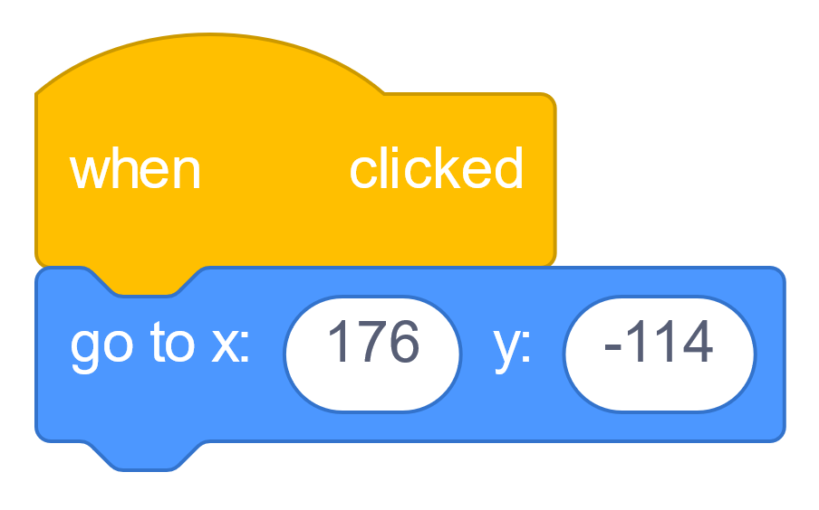

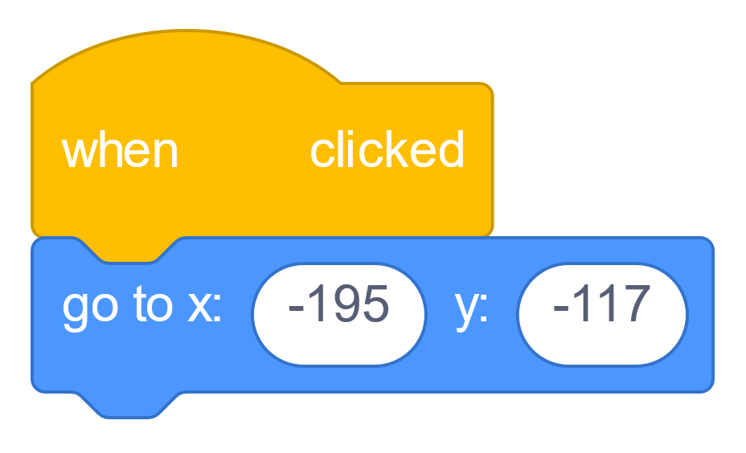
Get in Place!

Slide 8
Not Facing the Bus!

Slide 9
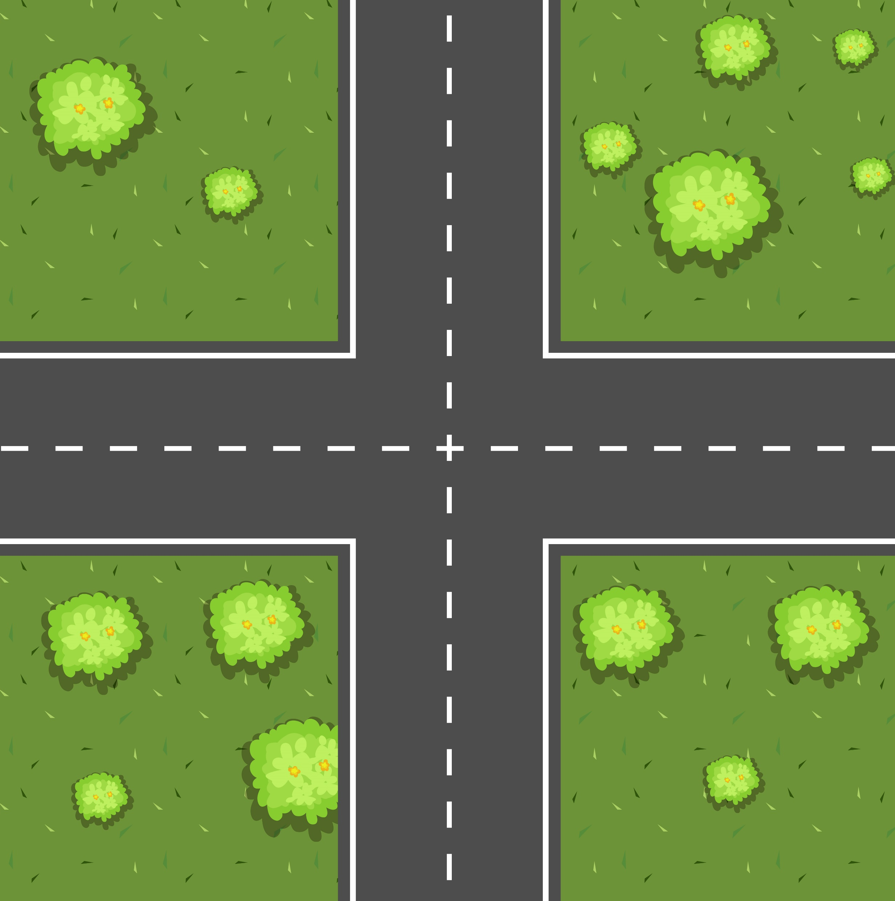

Directions
North
West
East
South

Slide 10
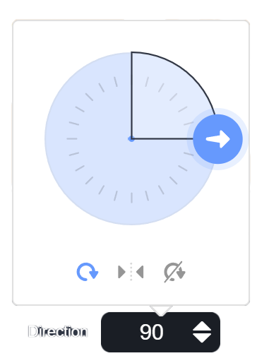
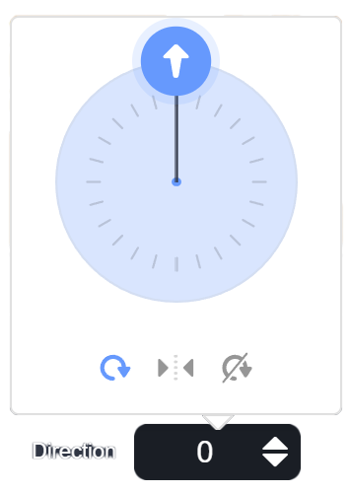
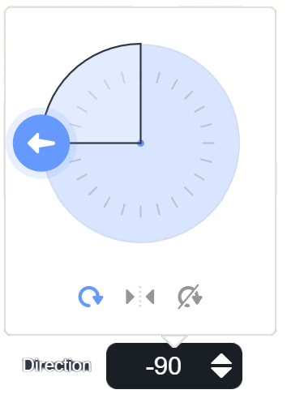
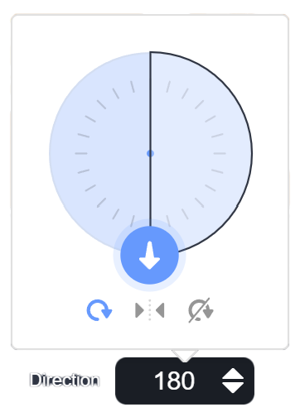
Direction Clock

Slide 11
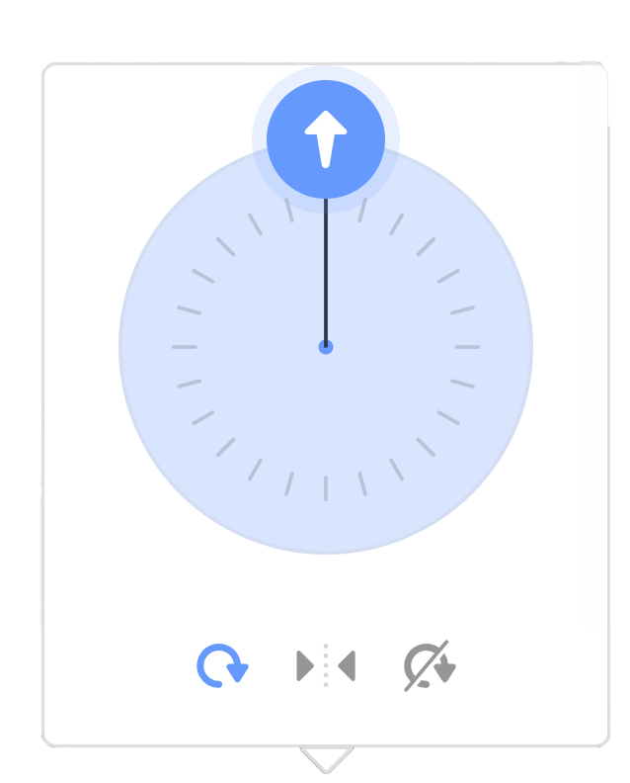

Direction Clock
-1°
0°
-179°
180°

Slide 12
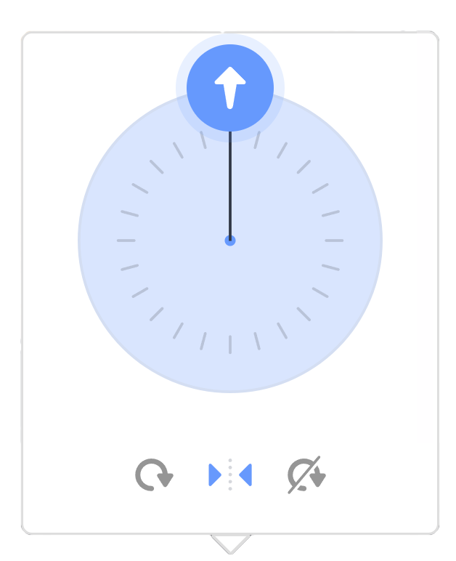
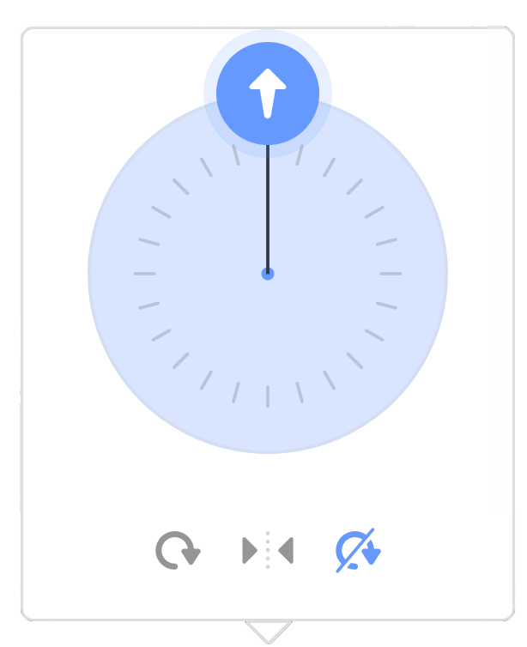
Rotation Style
All Around
Left/Right
Do not Rotate

Slide 13
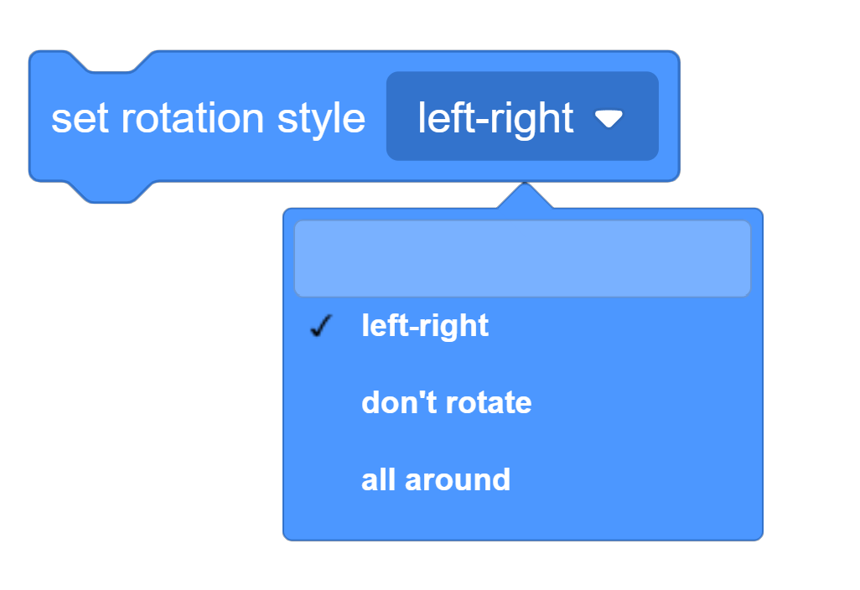
Set Rotation Style

Slide 14

Set Direction

Slide 15
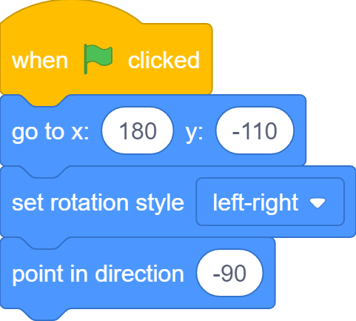
Face the Bus

Slide 16
What we learnt…

Slide 17
Exercises
Have fun with some of the other effects
Try different sprites and backdrops
Say and think differently
Checkout costumes of other sprites
Invent your own way of communication!

Slide 18
Thank you and see you in the next lesson!

